Slide 1
Reinventing Grocery Shopping with Reinforcement Learning

Slide 2
Topics
Introduction
Objective
Problem Statement
Scope
Benefits
Literature Survey
Challenges
Proposed Framework / Methodology
Implementation work
Result
Conclusion
Future work
References

Slide 3
Introduction
Grocery shopping is a routine yet time-consuming task that often involves visiting multiple stores to find the best deals and products. To alleviate the burden of this process and optimize the shopping experience, we propose the development of an agent-based grocery shopping system. This system aims to automate and optimize the grocery shopping process by leveraging artificial intelligence techniques, specifically reinforcement learning.

Slide 4
Objective
The primary objective of this project is to design an intelligent system capable of making informed decisions regarding where to shop and what seller to choose.
The system able learns to navigate through different shops, considering factors such as item availability, prices, and distances between stores. Through iterative learning episodes, the system refines its decision-making policy to maximize rewards, such as cost savings and minimized travel distances.

Slide 5
Problem Statement
The traditional process of grocery shopping often involves significant time and effort spent visiting multiple stores in online and offline to find desired items at competitive prices. This process can be particularly burdensome for individuals with busy schedules or specific preferences. Current online grocery platforms offer convenience but may lack the ability to tailor recommendations to individual preferences effectively.
To address these challenges, we propose the development of an agent-based grocery shopping system. This system aims to automate and optimize the grocery shopping process by utilizing RL agents to gather information from various stores and compare it with user preferences.

Slide 6
Scope
Multi-Criteria Decision Making
User Preferences Learning
Real-time Price Tracking
Sentiment Analysis of Reviews
Integration with E-commerce Platforms
Notes:
Multi-Criteria Decision Making:
Scope: The RL agent can be designed to consider multiple criteria simultaneously, such as product reviews, price, distance to the user, and any other relevant factors.
Benefits: Enhancing the decision-making process for users by providing a more comprehensive analysis of products.
User Preferences Learning:
Scope: The RL agent can learn and adapt to individual user preferences over time by analyzing their historical interactions, purchases, and feedback.
Benefits: Personalizing recommendations based on each user's unique preferences, leading to higher user satisfaction.
Real-time Price Tracking:
Scope: The RL agent can continuously monitor and track real-time changes in product prices, adapting recommendations accordingly.
Benefits: Providing users with up-to-date information on the best deals and helping them save money.
Sentiment Analysis of Reviews:
Scope: Implement sentiment analysis to assess the sentiment of user reviews and factor it into the RL agent's decision-making process.
Benefits: Considering user satisfaction and sentiment towards products, contributing to more informed recommendations.
Integration with E-commerce Platforms:
Scope: Integrate the RL agent with e-commerce platforms, allowing it to access a wide range of product data, reviews, and real-time pricing information.
Benefits: Expanding the scope and data availability, leading to more accurate and comprehensive recommendations.

Slide 7
Benefits
Efficiency Improvement:
RL agents can automate decision-making processes, leading to more efficient and timely operations.
Cost Reduction:
Optimization of inventory, pricing, and logistics can result in cost savings throughout the supply chain.
Enhanced Customer Experience:
Personalized recommendations, optimized store layouts, and efficient checkout processes contribute to a better overall shopping experience.
Increased Revenue:
Dynamic pricing strategies and personalized promotions can lead to increased sales and revenue.
Adaptability to Changing Conditions:
RL agents can adapt quickly to changing market conditions, ensuring that strategies remain effective over time.

Slide 8
Literature Survey
S.NO | Year of Publishing | Paper
1. | July, 2000 | Agent-based Grocery Shopping System Based on User's Preference( Survey Paper).
2. | August ,2007 | Agent-based simulation of consumer behavior in grocery shopping on a regional level.
3. | May, 2017 | Evaluating the potential of agent-based modelling to capture consumer grocery retail store choice behaviours.

Slide 9
Challenges
Sparse Rewards
High-Dimensional State Space
Dynamic Environment
Exploration-Exploitation Tradeoff
User Privacy and Sensitivity
Multi-Agent Interactions
Model Robustness
Cost Sensitivity
Notes:
Sparse Rewards:
Defining a reward function that accurately represents user satisfaction in online grocery shopping can be challenging. Rewards might be sparse, making it difficult for the RL agent to learn and optimize its behavior.
High-Dimensional State Space:
The state space in online grocery shopping can be complex and high-dimensional. It includes various factors such as user preferences, product availability, delivery time slots, and pricing. Managing and representing such a vast state space efficiently can be computationally demanding.
Dynamic Environment:
The online grocery shopping environment is dynamic, with frequent changes in product availability, pricing, and user preferences. Adapting to these changes in real-time poses a challenge for RL algorithms, as they may need constant retraining or robust mechanisms to handle evolving scenarios.
Exploration-Exploitation Tradeoff:
Balancing exploration and exploitation is crucial in RL. In the context of online grocery shopping, the RL agent needs to explore new products and preferences to learn better strategies while exploiting known preferences to maximize user satisfaction. Striking the right balance is non-trivial.
User Privacy and Sensitivity:
RL algorithms might require access to sensitive user data to make personalized recommendations. Ensuring user privacy and gaining user trust while using their data for training models is a significant challenge.
Multi-Agent Interactions:
Online grocery shopping involves interactions between multiple agents, including the customer, the online platform, and potentially third-party delivery services. Coordinating these interactions to optimize overall system performance is a complex task.
Long-Term Planning:
Users often have long-term preferences and habits that extend beyond a single shopping session. Incorporating long-term planning into RL algorithms to provide consistent and satisfying recommendations over time is a challenge.
Model Robustness:
Ensuring that the RL model is robust to outliers, noise, or unexpected changes in the environment is crucial. This is particularly important in online grocery shopping, where factors like product unavailability or delivery delays can occur.
Cost Sensitivity:
RL algorithms need to be mindful of cost considerations, such as delivery fees and discounts, to provide economically sensible recommendations. Balancing user satisfaction with cost optimization adds complexity to the learning problem.

Slide 10
Proposed Framework…
This project addresses grocery shopping challenges by creating a simulated environment with diverse shops offering varied inventory and pricing. Agent state includes shop location and item buying status, guiding actions to navigate between shops. Policies, learned through reinforcement learning, inform decision-making. Positive rewards are given for finding items, with penalties for unavailability, travel, and higher-priced items. Transition probabilities model movement between states based on actions and outcomes, considering factors like shop distances and item prices. By integrating these elements, a realistic system optimizes shopping, guiding users to efficient choices and saving time.

Slide 11
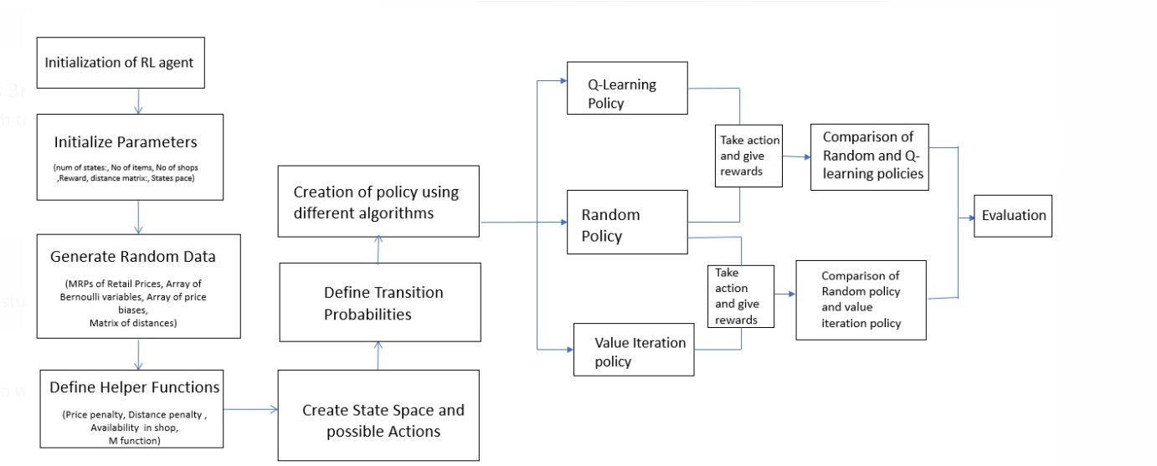
approach to reinventing grocery shopping Using Reinforcement Learning
Fig.1: Implementation of Grocery shopping

Slide 12
Q-Learning
In the context of grocery shopping optimization, Q-learning is used by the autonomous agent to learn the Q-values, which represent the expected cumulative rewards for taking a particular action in a given state.
The agent explores the grocery shopping environment by interacting with it, making decisions (actions) based on its current state and receiving feedback (rewards) based on the outcomes of its actions.
During each interaction, the agent updates its Q-values using the Q learning update rule, which incorporates the observed reward and the maximum Q-value of the next state.

Slide 13
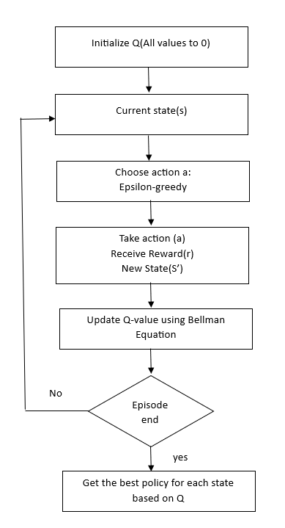
Implementation of
Q-learning

Slide 14
Value Iteration
In the grocery shopping optimization project, value iteration is used to compute the optimal value function by iteratively updating the values of each state based on the Bellman equation, which expresses the relationship between the value of a state and the values of its neighboring states.
The agent initializes the value function arbitrarily and then iteratively updates it until convergence, with each iteration bringing the values closer to their optimal values.
Once the optimal value function is computed, the agent can derive the optimal policy by selecting the action with the highest expected value in each state, enabling it to make decisions that maximize cumulative rewards.

Slide 15
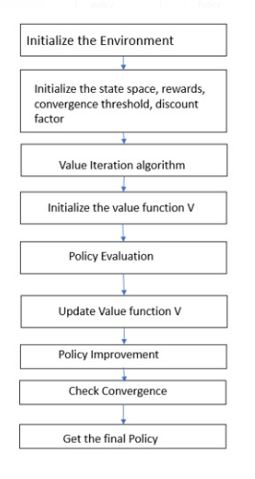
Value iteration
Methodology Flow
Chart

Slide 16
Random policy iteration
Random policies help with exploration by forcing the agent to try different actions, even if they might not be ideal based on current knowledge.
Random actions can nudge the agent out of this loop and potentially lead it to discover a more rewarding path.

Slide 17
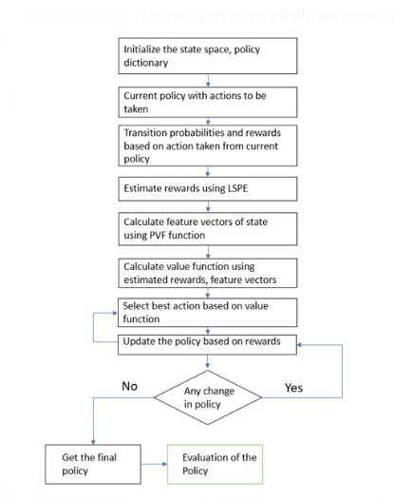
Random policy
iteration
implementation

Slide 18
Implementation
Initialization sets up parameters: item prices, shop count, and item count.
State space defines states with shop number and item buying status.
Transition probabilities and rewards model state changes based on actions.
Q-learning iteratively learns optimal policies via state-action values.
Testing compares learned policy against random policy via simulated scenarios.
Visualization aids understanding with reward plots and optimal policy display.

Slide 19
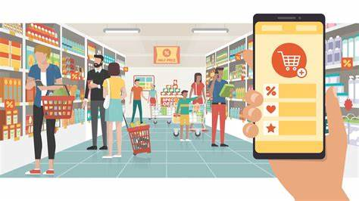
Result

Slide 20
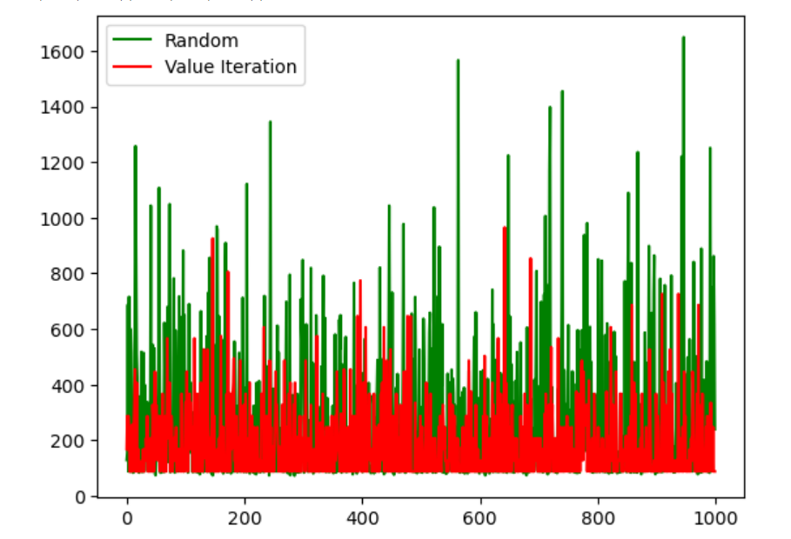
With Value Iteration

Slide 21
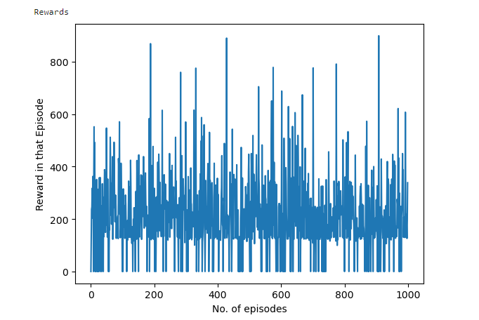
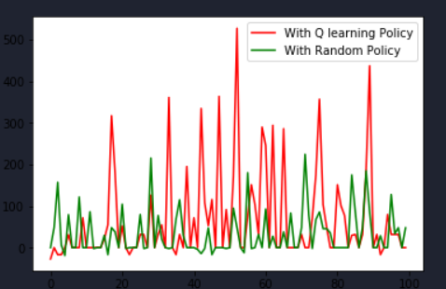
With Q-Learning

Slide 22
Conclusion…
In conclusion, the application of reinforcement learning (RL) techniques offers a promising avenue for optimizing the grocery shopping experience. Through iterative interactions with the environment, RL-powered agents can learn and refine optimal strategies tailored to individual preferences, budget constraints, and time limitations. By maximizing cumulative rewards such as cost savings, time efficiency, and customer satisfaction, these agents streamline the shopping journey for consumers. The implementation of value iteration, Q-learning, and representation policy iteration methods enables continuous improvement in decision-making policies, leading to enhanced shopping experiences.

Slide 23

Future work

Slide 24
Real-Time Adaptation: Developing adaptive RL algorithms capable of dynamically adjusting shopping strategies in response to real-time changes in factors such as product availability, pricing fluctuations, and store layouts.
Integration with E-commerce: Expanding RL-based optimization techniques to online grocery platforms, enabling seamless integration between physical and digital shopping experiences, and leveraging data-driven insights to enhance customer satisfaction and operational efficiency.

Slide 25
References…
A deep reinforcement learning approach for the meal delivery problem – ScienceDirect
GitHub - manasimalik/RL-For-Grocery-Shopping-Solutions: When we want to purchase our monthly grocery, there are multiple store options with different pricings and availability. There is also a cost attached to travelling to these stores. Using reinforcement learning, we model these variables to learn the best strategy to purchase all the items we want.
Anticipatory Decisions in Retail E-Commerce Warehouses using Reinforcement Learning | Proceedings of the 3rd ACM India Joint International Conference on Data Science & Management of Data (8th ACM IKDD CODS & 26th COMAD)

Slide 26

Name : Mandadi Geetha Pallavi
Reg No: 21BCE7286
School : SCOPE
Name: Mallampati Bhavishya
Reg Number: 21BCE7418
School: SCOPE
Name: Gandla Sreeja
Reg Number: 21BCE9098
School: SCOPE

Slide 27
Thank you

